Slide 1
Review & compare two different kinds of mobile app
Purposes of mobile apps
Notes:
Today we will review and compare two different kinds of mobile apps

Slide 2
About what this presentation
Of course, one application can contain a lot of functions that will relate to several genres at the same time.
But such an application will be overloaded and most likely will not be used to its full potential as intended, and in addition to this, relatively little popularity.
An example of this is the large corporation Google, it has everything divided into sub-services, which does not create a monolithic structure of genres, but rather - for each need and genre - a different application or service. So we can compare Google's internal services, as well as it with other analogues.

Slide 3
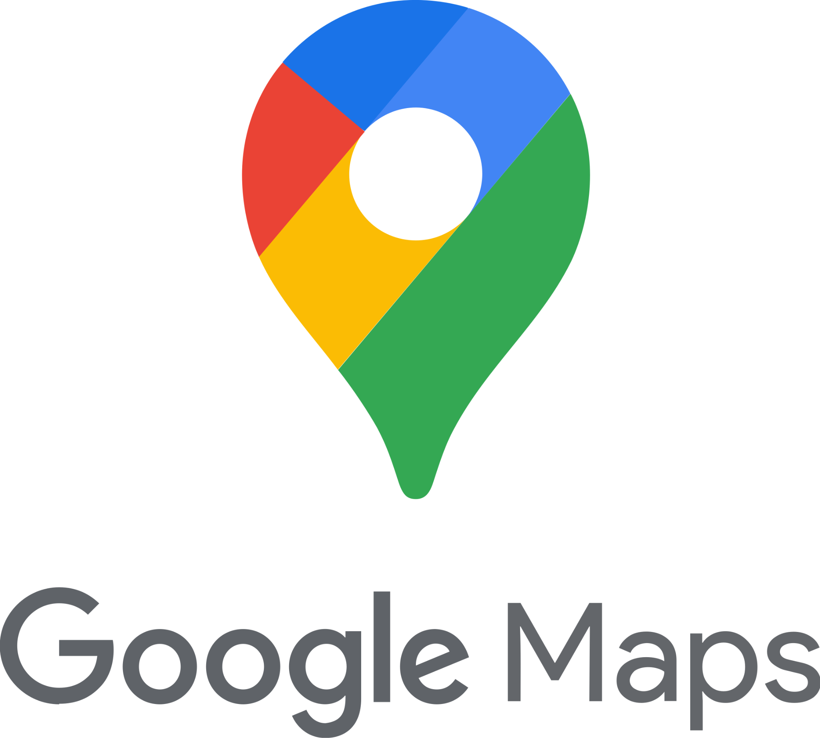

Subject of comparison
So I want to compare google maps and spotify. It would seem that maps are needed for navigation, and Spotify is for entertainment, that is, listening and downloading music, but they have a lot in common and are different.
Notes:
We compare two different types of applications to understand what problems they can solve and somehow compare what can be more useful and what can be transferred to your application

Slide 4
Understanding the problems
01
Google maps - One of the main problems of people was and will be navigation. People always need to get somewhere on time and in the optimal way for them. This program shows it well.
02
Spotify - Despite navigation and other problems, people need to be able to enjoy something, maybe just to pass the time, and music helps a lot with that. And this program is an audio streaming service that allows you to listen to this music.
Notes:
People need to understand what problem this app can solve, so you need to convey the short meaning of the app through the problem.

Slide 5
Google Maps Description
GMaps is usually used to search for a place, shop, etc. on the map, navigate to this city, view ways to get to this city. It is very convenient for tourists, non-local residents of a new city, or for people who do not know much about their city and want to discover new shops without problems with the road to this city.
Notes:
GMaps is usually used to search for a place, shop, etc. on the map, navigate to this city, view ways to get to this city. It is very convenient for tourists, non-local residents of a new city, or for people who do not know much about their city and want to discover new shops without problems with the road to this city.

Slide 6

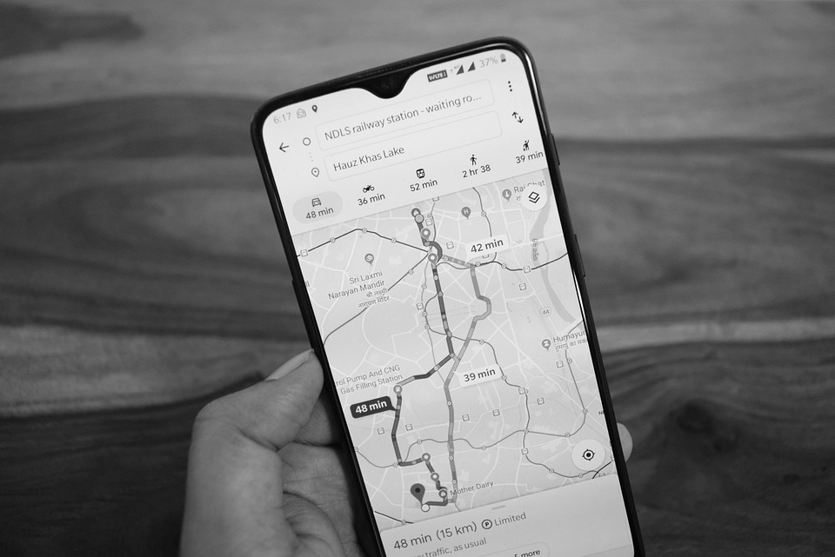

GMaps - Example of usage
That is, what is the algorithm - you came to Paris, for example, and you want to go to the Eiffel Tower, but it will not be easy to do it if you are not a local, so you can use signs, ask a guide, look at the transport schedule, but it is long and difficult, gmaps does it all for you, gives the optimal route to get there, sometimes can even show the fare. Can also be used as a car navigator.
That is, it has a positive effect on the person who uses it, it simplifies a lot of things, and does it much faster than a person can. I believe that these functions are completely related to the genre of navigation.
Notes:
We briefly prove with a real example that the application is really useful and can be used in such events

Slide 7
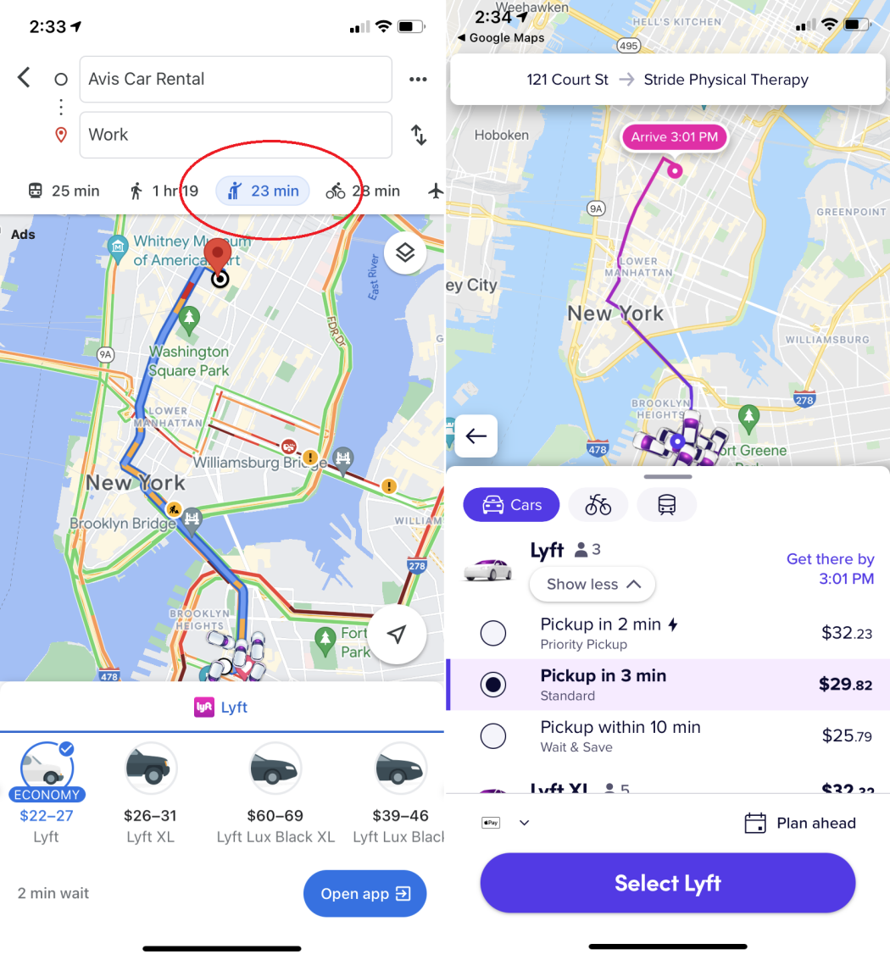
Google Maps Features
You can use Google Maps on your phone
- possibility to add your own points.
- you can save these places
- view seat updates
- viewing and saving the timeline
- the ability to view almost any point on
the planet where a car can pass or a
person can leave the panorama.
- the ability to share your location with
someone
- use geolocation to show the
route and location of public transport,
and leave feedback, and the number
of people inside.
Notes:
You can use Google Maps on your phone because usually it’s a primary people or tourist device

Slide 8
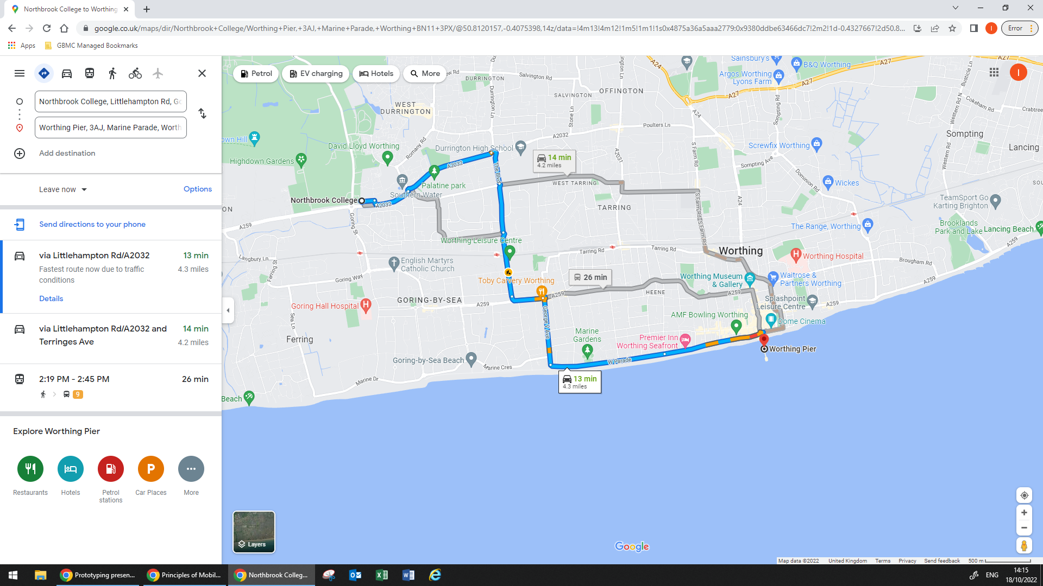
Google Maps Features
Also you can use Google Maps on your PC or Laptop as well
- Laying the route from point A
to point B
- choosing the optimal route, if
there are several of them
- an opportunity to see the
transport schedule to get
there on this route.
- mobile navigator
- Ability to leave a review about
a store or city, attach a photo
- View a 3D panorama of a
place, road, etc. and move
through it.
- Synchronisation with other Google Services
Notes:
Also you can use Google Maps on your PC or Laptop as well, introduce google maps cross-platform and useful features which users can use

Slide 9
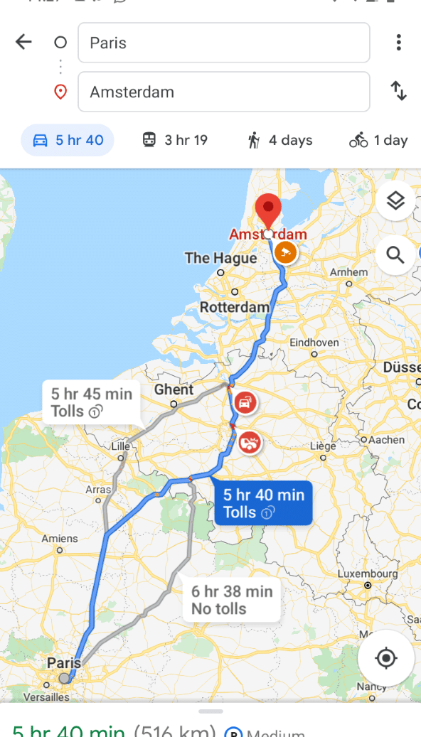
Google Maps Key Features and Characteristics
Key Features
Characteristics
- Navigation can be done by voice
command of the assistant, in Google,
widgets, links, and already saved
templates
- It is possible to synchronize with the cloud, other users, add events to the calendar, clock, widgets for the desktop and the lock screen and full integration with other google services like a Google Calendar, Notes etc
- Application navigation is built on
Material UI, so there won't be any
unfamiliar features.
- The design is adaptive, suitable for
most devices
- It needs at least some capacity from
barely, as there are heavy parts that
require good performance
- It exists on almost all platforms, i.e.
web, standalone applications, mobile,
watches
Notes:
Navigation can be done by voice command of the assistant, in Google, widgets, links, and already saved templates
It is possible to synchronize with the cloud, other users, add events to the calendar, clock, widgets for the desktop and the lock screen and full integration with other google services like a Google Calendar, Notes etc

Slide 10
Google Maps Strengths and Weaknesses
Strengths
Weaknesses
Since the author of this application is a leading megacorporation, it will immediately have some popularity among users.
But the convenience of the interface and work with features makes this application one of the best, it provides all the necessary package of functions for tourists, or residents of a new place, etc.
And integration with all of other google services.
- Information on Google Maps may contain errors.
Sometimes ambiguity and gaps in location data can result
in a route that does not take you to your expected
destination. Google Maps does not have up-to-date
information on unusual conditions, such as roads damaged
by weather, blocked by street fairs, or altered by recent
construction work. Some remote locations may not be on.
- Thieves do not lose the convenience of Google Maps.
In Street View images, you can see things that are
momentarily exposed through windows or open doors.
Burglars have used street view and satellite imagery to find
affluent neighbourhoods or homes that are easy to break
into, or to identify parked cars that may contain valuables.
- Offensive and shocking materials
Notes:
Since the author of this application is a leading megacorporation, it will immediately have some popularity among users.
But the convenience of the interface and work with features makes this application one of the best, it provides all the necessary package of functions for tourists, or residents of a new place, etc.
And integration with all of other google services.
But any app or service have a weaknesses, google maps have too:
- Information on Google Maps may contain errors.
Sometimes ambiguity and gaps in location data can result
in a route that does not take you to your expected
destination. Google Maps does not have up-to-date
information on unusual conditions, such as roads damaged
by weather, blocked by street fairs, or altered by recent
construction work. Some remote locations may not be on.
- Thieves do not lose the convenience of Google Maps. In Street View images, you can see things that are momentarily exposed through windows or open doors.
Burglars have used street view and satellite imagery to find affluent eighbourhoods or homes that are easy to break into, or to identify parked cars that may contain valuables.
- Offensive and shocking materials

Slide 11
Spotify Description
This is an entertainment streaming application, so one of its main goals is to kill time with pleasure, maybe even educational.
You can even use it together with Google Maps, because going somewhere is more pleasant with music.
Notes:
This is an entertainment streaming application, so one of its main goals is to kill time with pleasure, maybe even educational.
You can even use it together with Google Maps, because going somewhere is more pleasant with music.

Slide 12
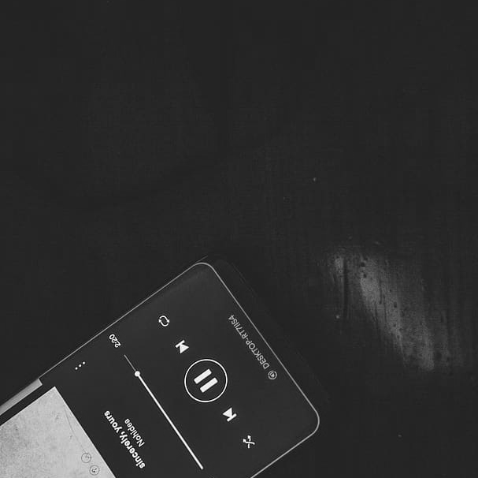
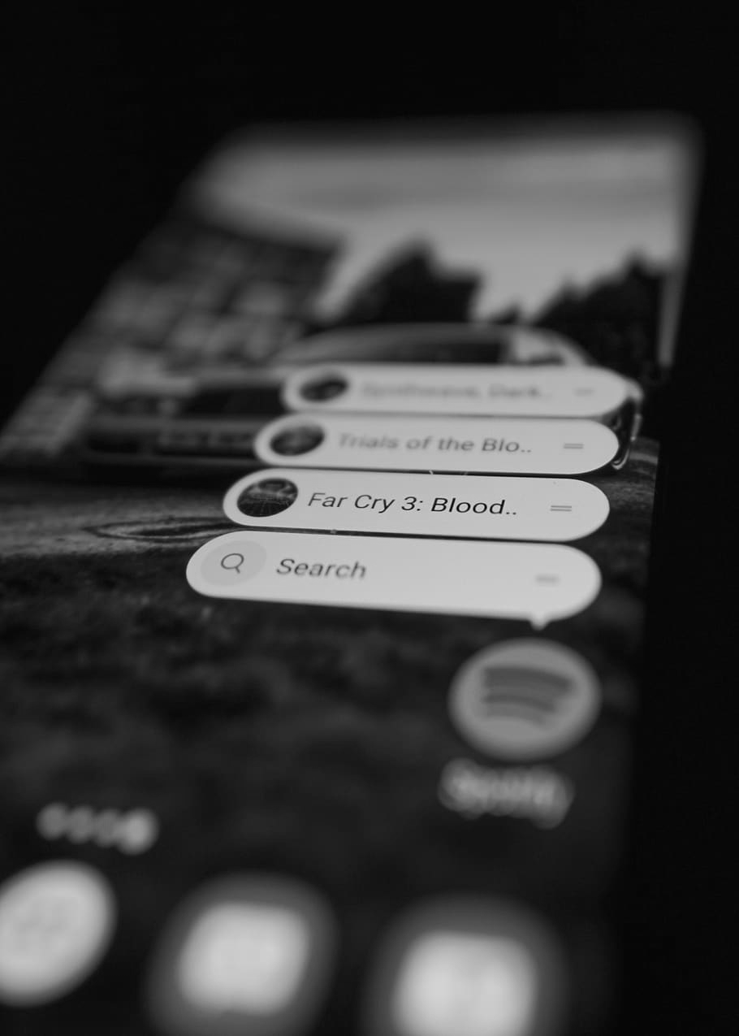
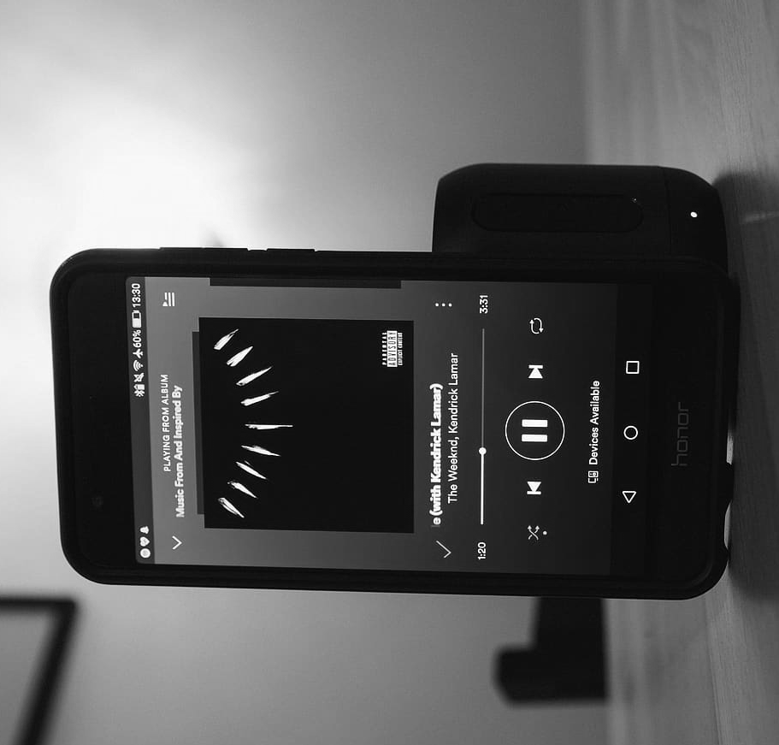
Spotify - Example of usage
So, a usage example: you are a music lover who listens to your favorite music anytime, anywhere. So, you create an account on the platform, download the application to your device, buy a subscription or use the free functionality, create playlists or search for ready-made ones of other users, and enjoy the music
Notes:
We briefly prove with a example that the application is really useful and can be used in such events

Slide 13
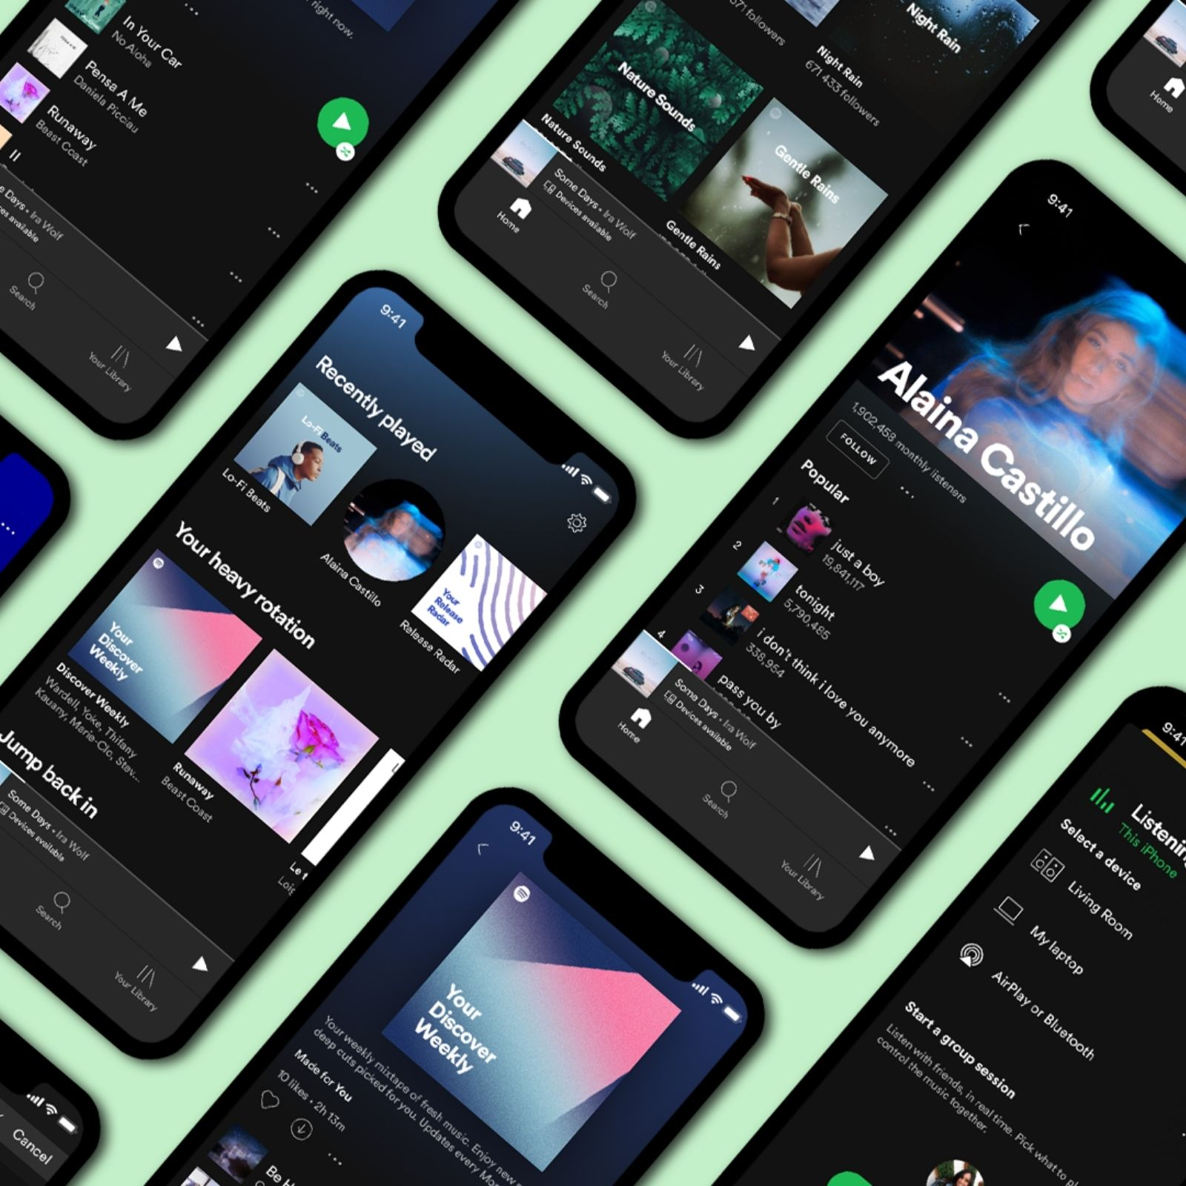
Spotify Features
You can use Spotify on your phone
Share music with friends using Spotify Codes - Allows you to quickly share a playlist or songs by scanning the code with another device with the application. This removes the need to throw someone a link via messenger, but does not completely eliminate such a possibility.
Follow friends - This way, you can see which track your friend is listening to, and it's also easier to interact with him, for example, to make collaborations
Collaborative playlists - If, for example, friends have common tastes in music, they can create a collaborative playlist that will take into account the tastes of all members of the playlist and search for songs based on them, as well as make mixes from their already selected songs.
Radio opinion based on artist
Filter out the chaff
Sort your search
Daily mixes -if you are already tired of a certain style of your music, you can learn something new for yourself in such mixes
Control it with your voice - it's convenient if you don't want to manually search for a menu item or search for a song by text, then you can remotely give a voice command to fulfill the request
Listen through your home cinema speakers - improve better listening
Notes:
Let us know that the user has a large selection of features and that they are simple and very convenient to use and he can use them without any problems to increase the level of enjoyment of using this application and listening to music

Slide 14
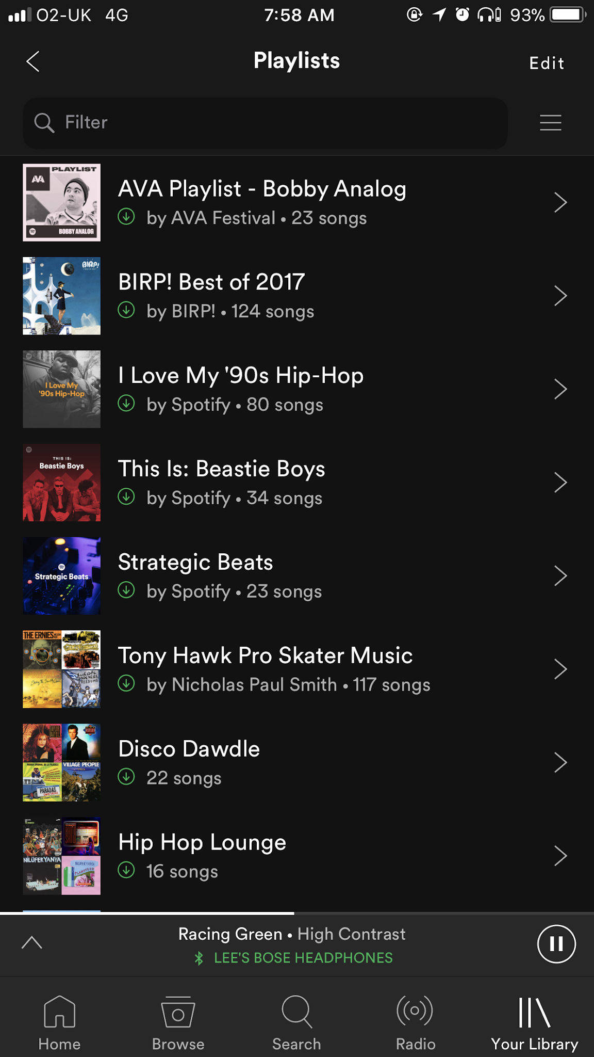
Spotify Features
You can use Spotify on your phone
Send music to your speakers with Spotify Connect - It is very convenient when, for example, you have the Spotify application on your computer and phone, the PC most likely has speakers connected, so the sound will be better and louder, so in the list of devices on the phone you can choose what you want to broadcast the sound to the PC, so you will control audio line from the phone.
Listen in your Uber
Share songs instantly with anyone - you can use Share Play to play music simultaneously with another person who is nearby or very far away, it was relevant during the quarantine period, when several people could listen to mixes or something else at the same time, you can even make some simple discos in this way
Preview music on iOS
Use private listening to hide your guilty pleasures
Link to a specific part of a track - convenient if you want to share the drop of the song with someone so that the person does not waste time listening to the entire track
Make a playlist tailored to your running speed
Listen to podcasts - good for news and education
Notes:
You can use Spotify on your phone for many features

Slide 15
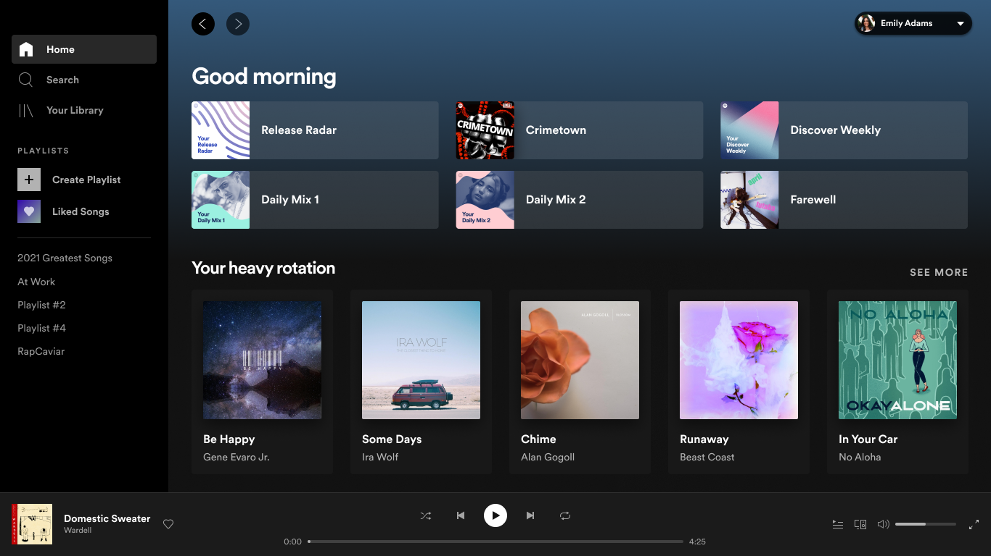
Spotify Features
Also you can use Spotify on your PC or Laptop as well
Possibility to set sound quality - If you are a music lover, then sound quality is definitely important to you, so you can change the bitrate, use the equalizer.
Search and play music
Search and follow to artist
Searching playlists
Save music for offline listening - It happens that there is not always access to the Internet, so you can download your favorite playlist and listen to it anywhere
Creating a playlists -A good way to collect your favorite music in one place, and it's easier to share it with friends
Transfer music from other apps - A relevant function for those who have switched from another platform, for example, from YouTube Music, and you do not want to collect all your tracks anew, so a simpler solution would be to transfer playlists. This saves a lot of time
Sorting now-playing queue
Search for your favourite tunes
Listen using browser or desktop app Listening to music on speakers is usually much more enjoyable because it is most likely using a good audio system that provides a good listening experience
Master keyboard shortcuts
Building own library
Add music that isn’t on Spotify
Recover a deleted playlist
Notes:
Introduce spotify cross-platform and useful features which users can use

Slide 16
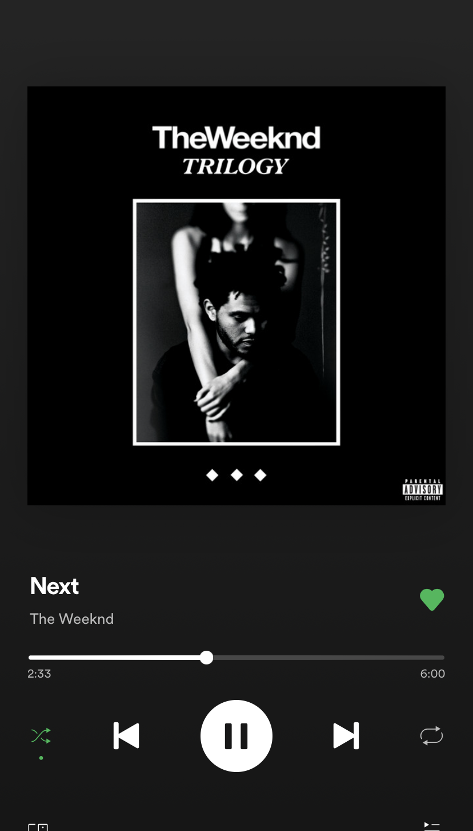
Spotify Key Features and Characteristics
Key Features
Characteristics
Navigation can be done by voice command of the assistant, widgets, links, sharing or app instantly.
In-app navigation can be done with taps on cards with music info and playlist with them, or using a search boxes.
It is possible to synchronize with the cloud, other users, add events to the calendar, clock, widgets for the desktop and the lock screen, load music from another platform like a YTMusics
Requires an internet connection to download music or listen to it non-offline mode
Preferably not a very weak device, because everything will be done on streams and streaming, so you will have to cache and process information in the background, which requires resources.
The interface is primitively understandable and gives the user a positive experience
After some time of listening and filtering music - the application itself will offer you music that you will like with a high probability
Notes:
Key Features of spotify:
Navigation can be done by voice command of the assistant, widgets, links, sharing or app instantly.
In-app navigation can be done with taps on cards with music info and playlist with them, or using a search boxes.
It is possible to synchronize with the cloud, other users, add events to the calendar, clock, widgets for the desktop and the lock screen, load music from another platform like a YTMusics

Slide 17
Spotify Strengths and Weaknesses
Strengths
Weaknesses
Very simple and user-friendly interface
One of the best apps because they pay attention to everything the user needs, use neural network analysis to build new playlists based on the user's preferences, so it provides a lot of options and functions through which you can search for music, build your library, adjust the taste of music, search for new artists, convenient share with other users, use multiple devices to play at the same time, control the application on one device from another, the ability to share status with someone, and play the same audio line with synchronization with another person or group of people
Sharing music experience
Compatibility - cross-platform - makes it possible to listen to your favorite playlists almost everywhere, in a browser, a desktop program for Windows, Linux, macOS, for iOS and Android phones, as well as control from smart watches, the ability to output sound to other devices such as portable speakers, speakers, audio systems, soundbars, etc.
Free tier - Although limited, most of the necessary functions are present, so the user can collect an almost unlimited number of songs, build playlists, listen to them, edit, share with friends, share activity, play on other devices
Lyrical Features
Very large potential and number of functions
a lot of features to improve the experience of working with collaborations with other users. For example, Spotify codes, shared playlists, generating and analyzing songs based on user preferences and filling this collaborative playlist with new songs
Expensive pro membership, very limited functional for free version.
Unwanted ads, and low bitrate in non-pro version
Low music bitrate and quality at all in non-pro version
Listening offline, downloading, skipping tracks only in pro version
Not Available in all Countries
Notes:
any app or service have a weaknesses, spotify have too:
Expensive pro membership, very limited functional for free version.
Unwanted ads, and low bitrate in non-pro version
Low music bitrate and quality at all in non-pro version
Listening offline, downloading, skipping tracks only in pro version
Not Available in all Countries

Slide 18
Ending
We analyzed two types of applications, from each of them you can borrow some features to make your product much better with their help. And also analyzed their strengths and weaknesses, so the weaknesses should be taken into account and try not to repeat similar ones in your products.
Notes:
We analyzed two types of applications, from each of them you can borrow some features to make your product much better with their help. And also analyzed their strengths and weaknesses, so the weaknesses should be taken into account and try not to repeat similar ones in your products.

